Slide 1


Slide 2
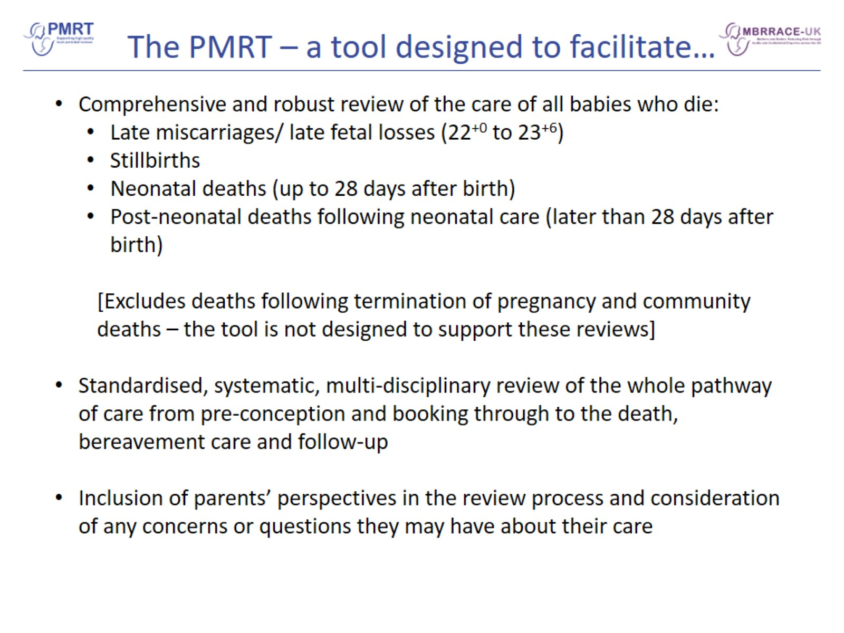
The PMRT – a tool designed to facilitate…

Slide 3
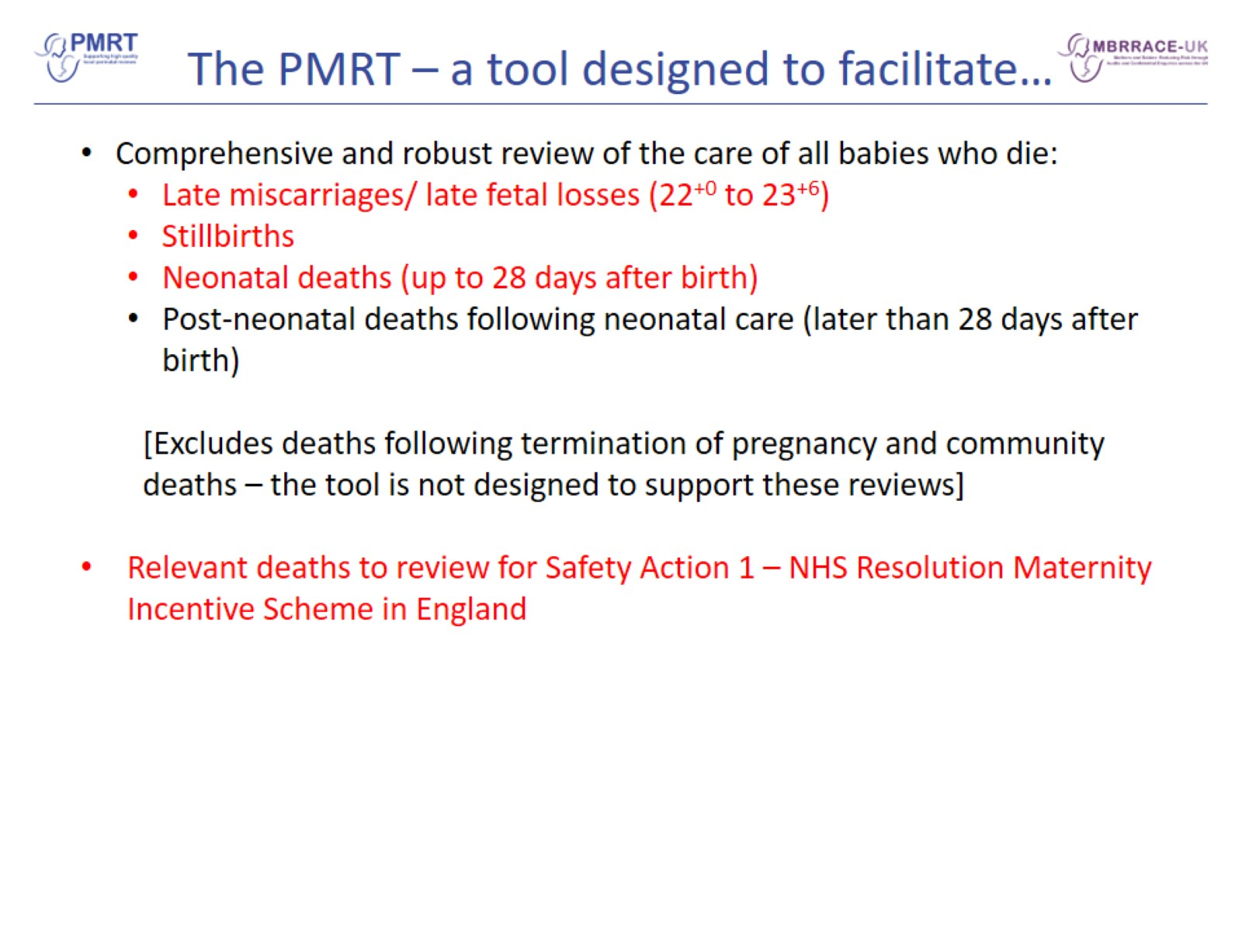
The PMRT – a tool designed to facilitate…

Slide 4
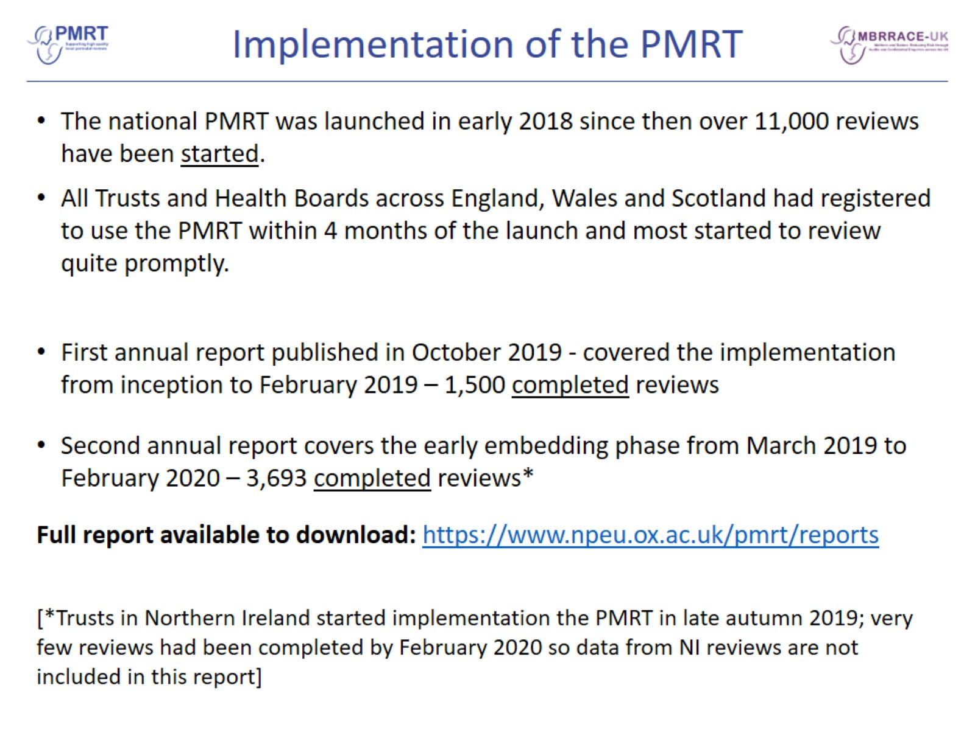
Implementation of the PMRT

Slide 5
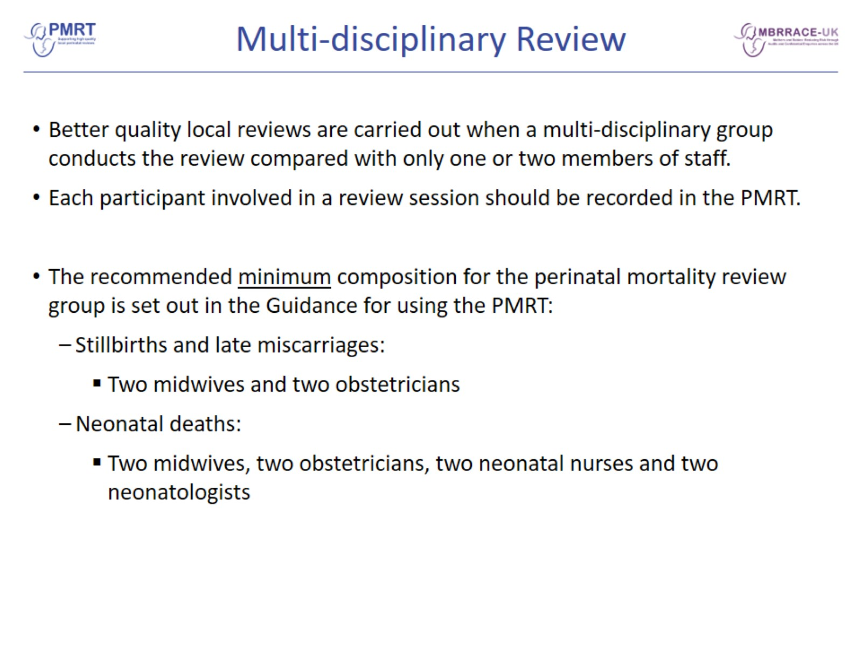
Multi-disciplinary Review

Slide 6
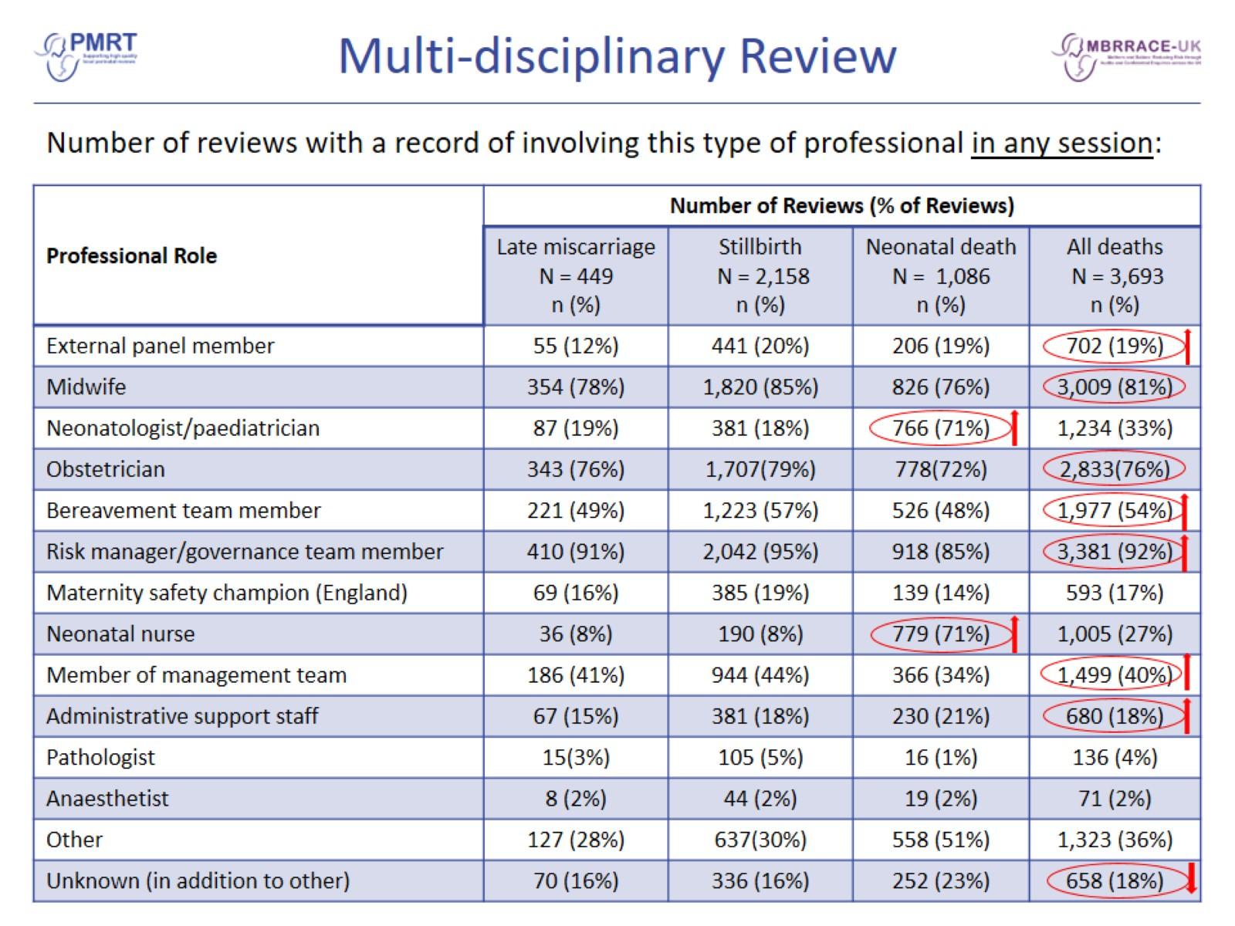
Multi-disciplinary Review

Slide 7
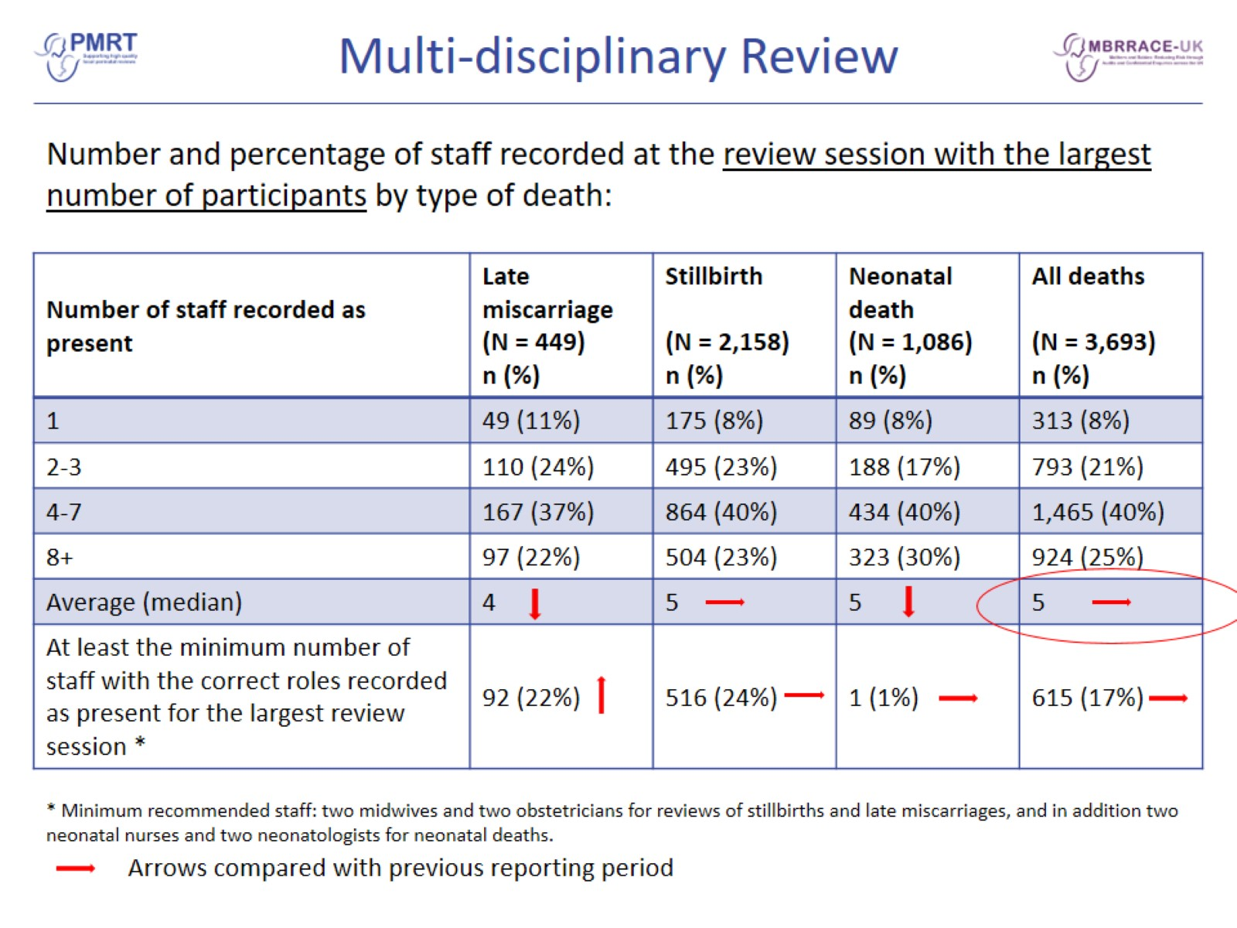
Multi-disciplinary Review

Slide 8
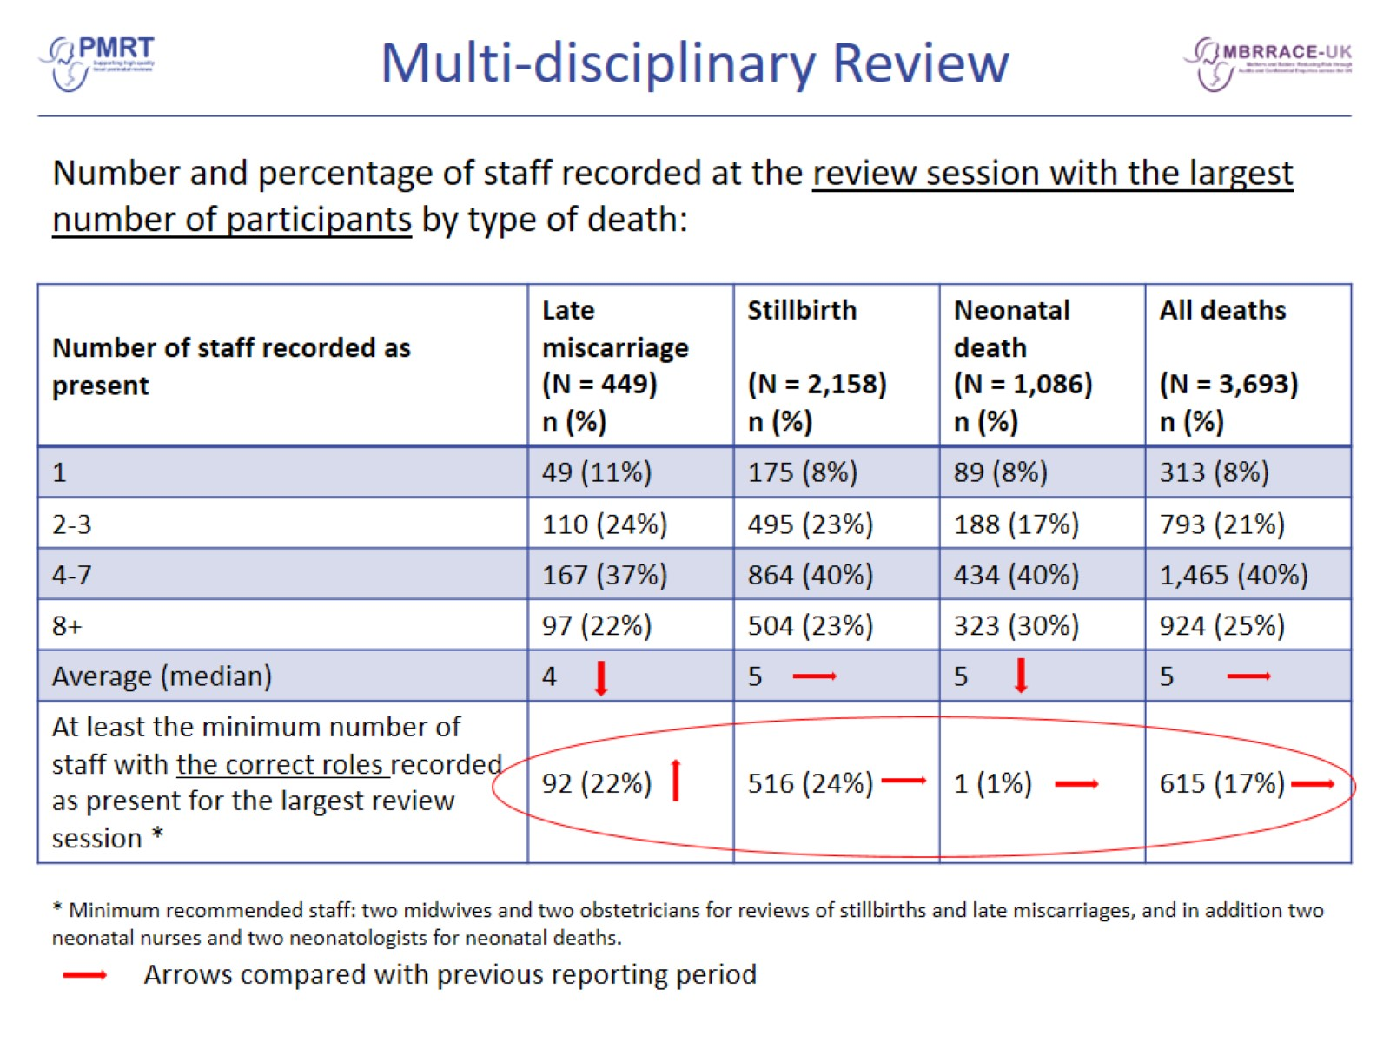
Multi-disciplinary Review

Slide 9
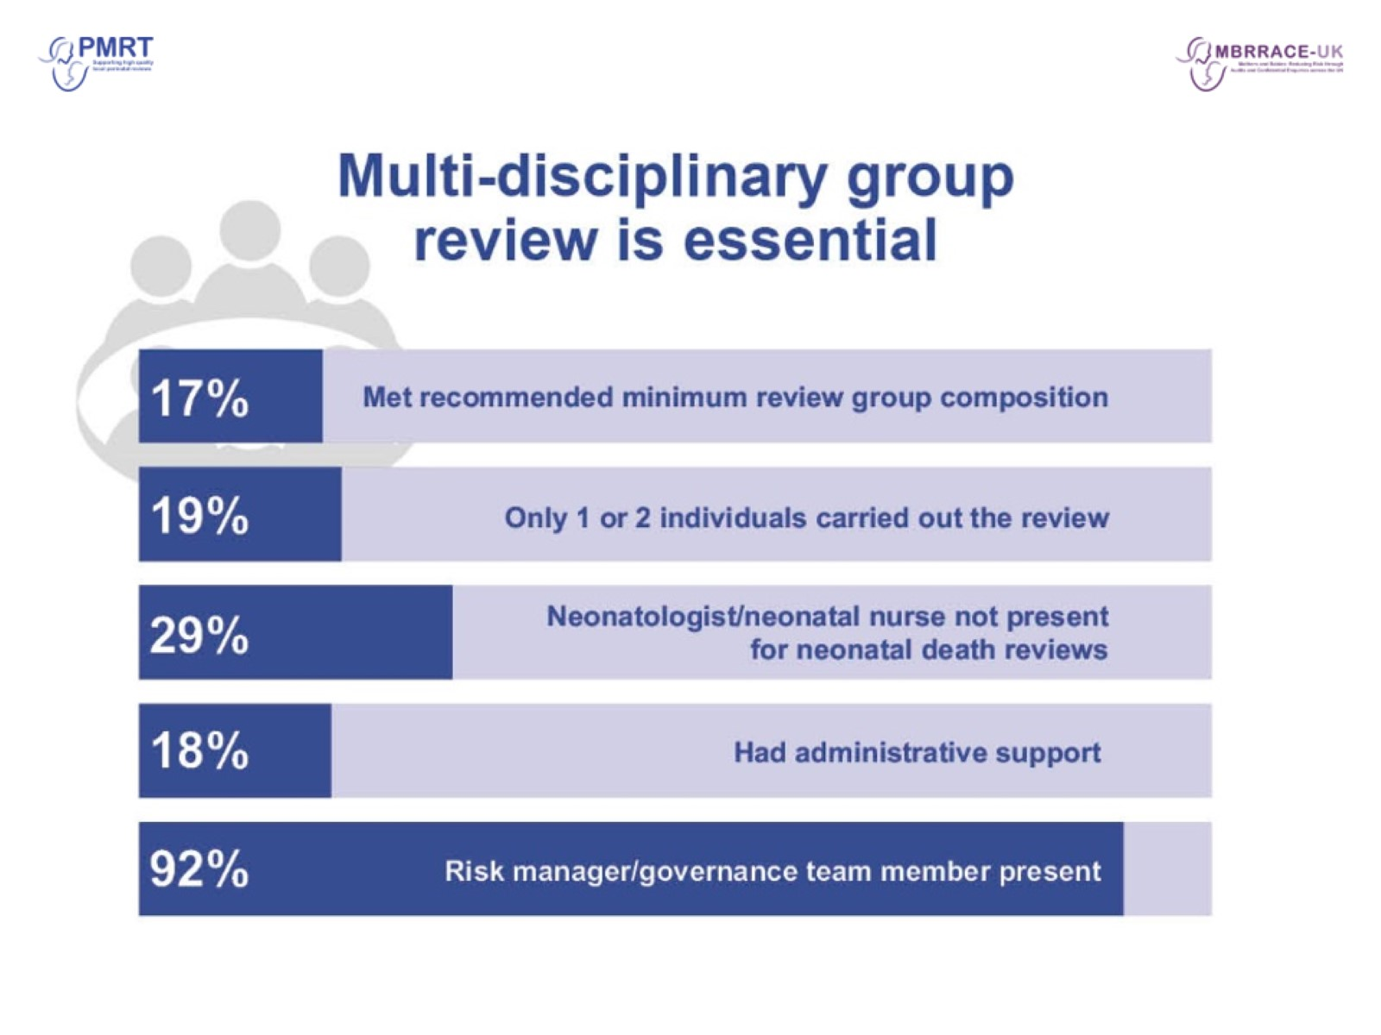

Slide 10
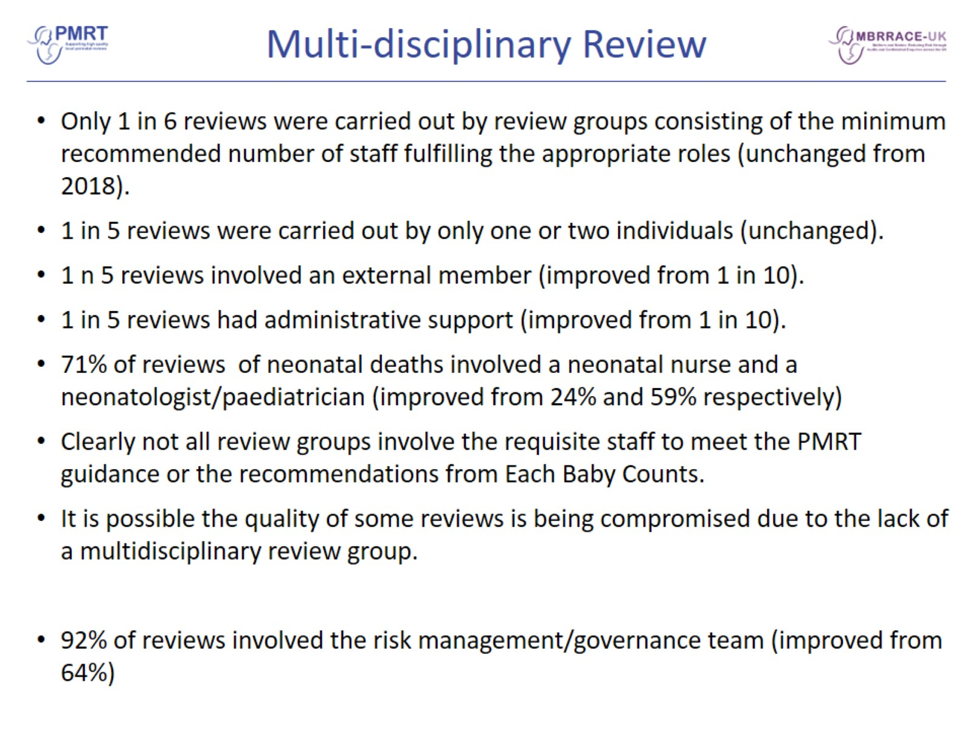
Multi-disciplinary Review

Slide 11
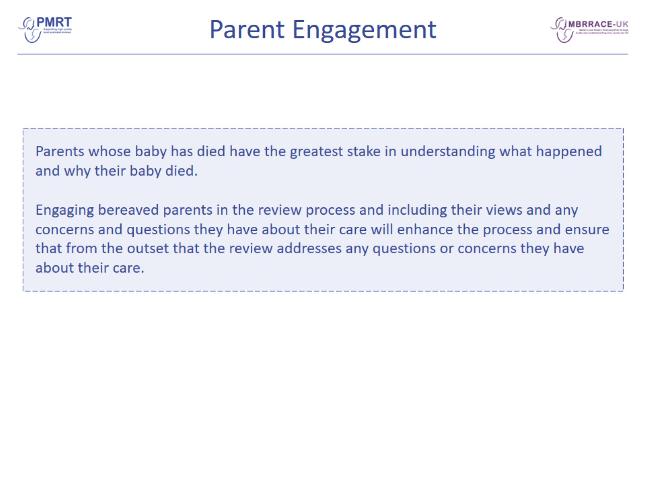
Parent Engagement

Slide 12
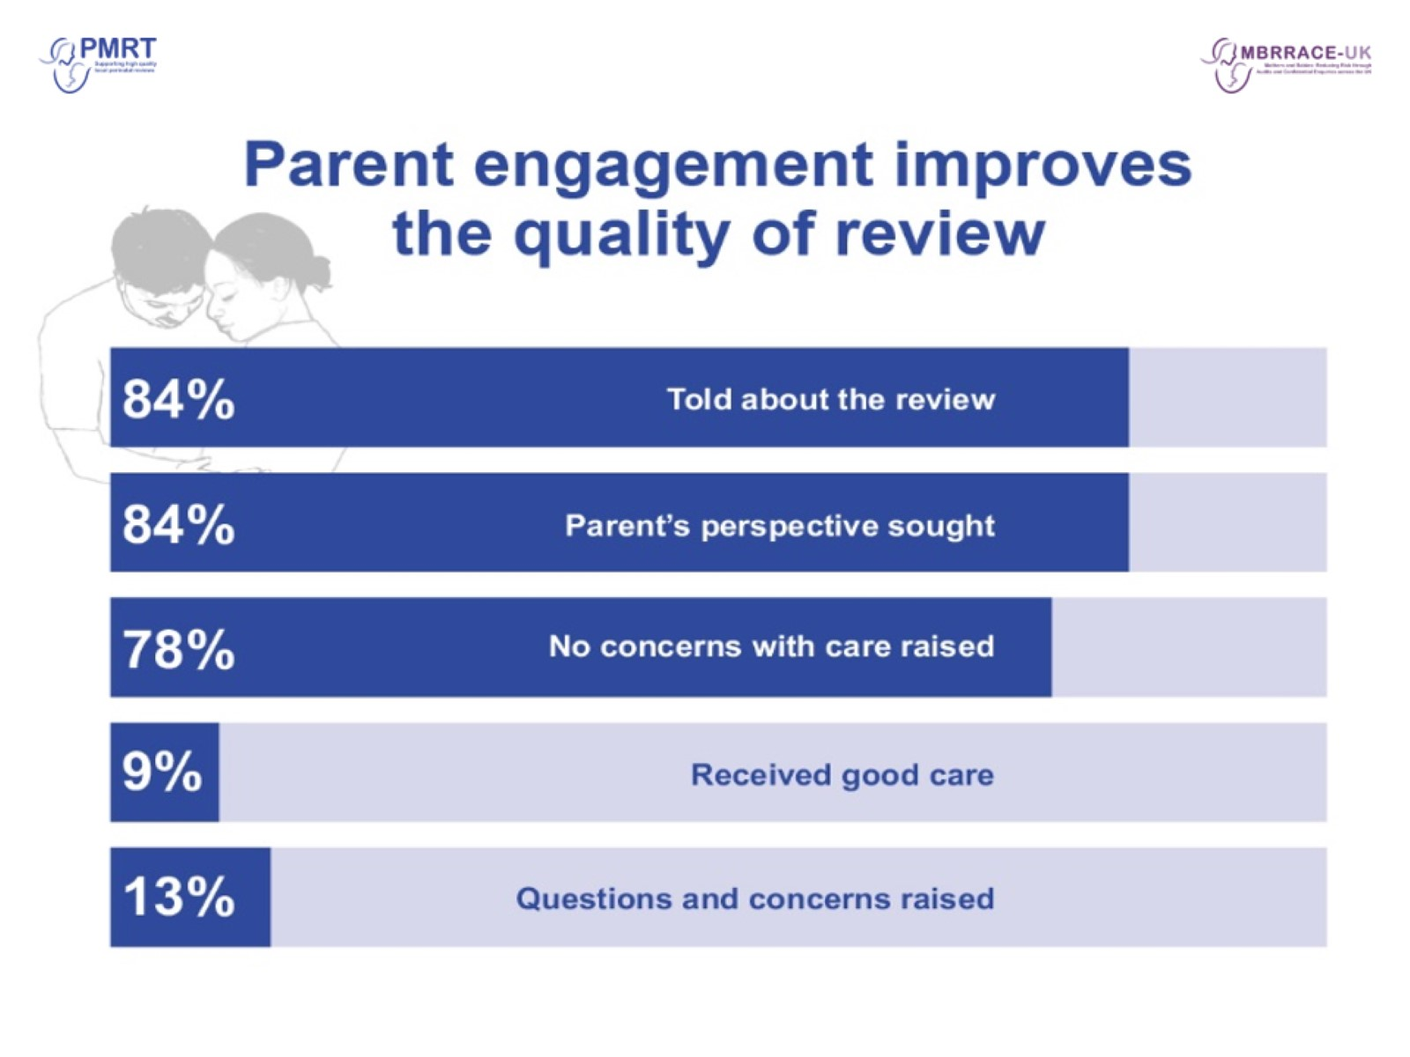

Slide 13


Slide 14

Engaging Parents in Reviews

Slide 15
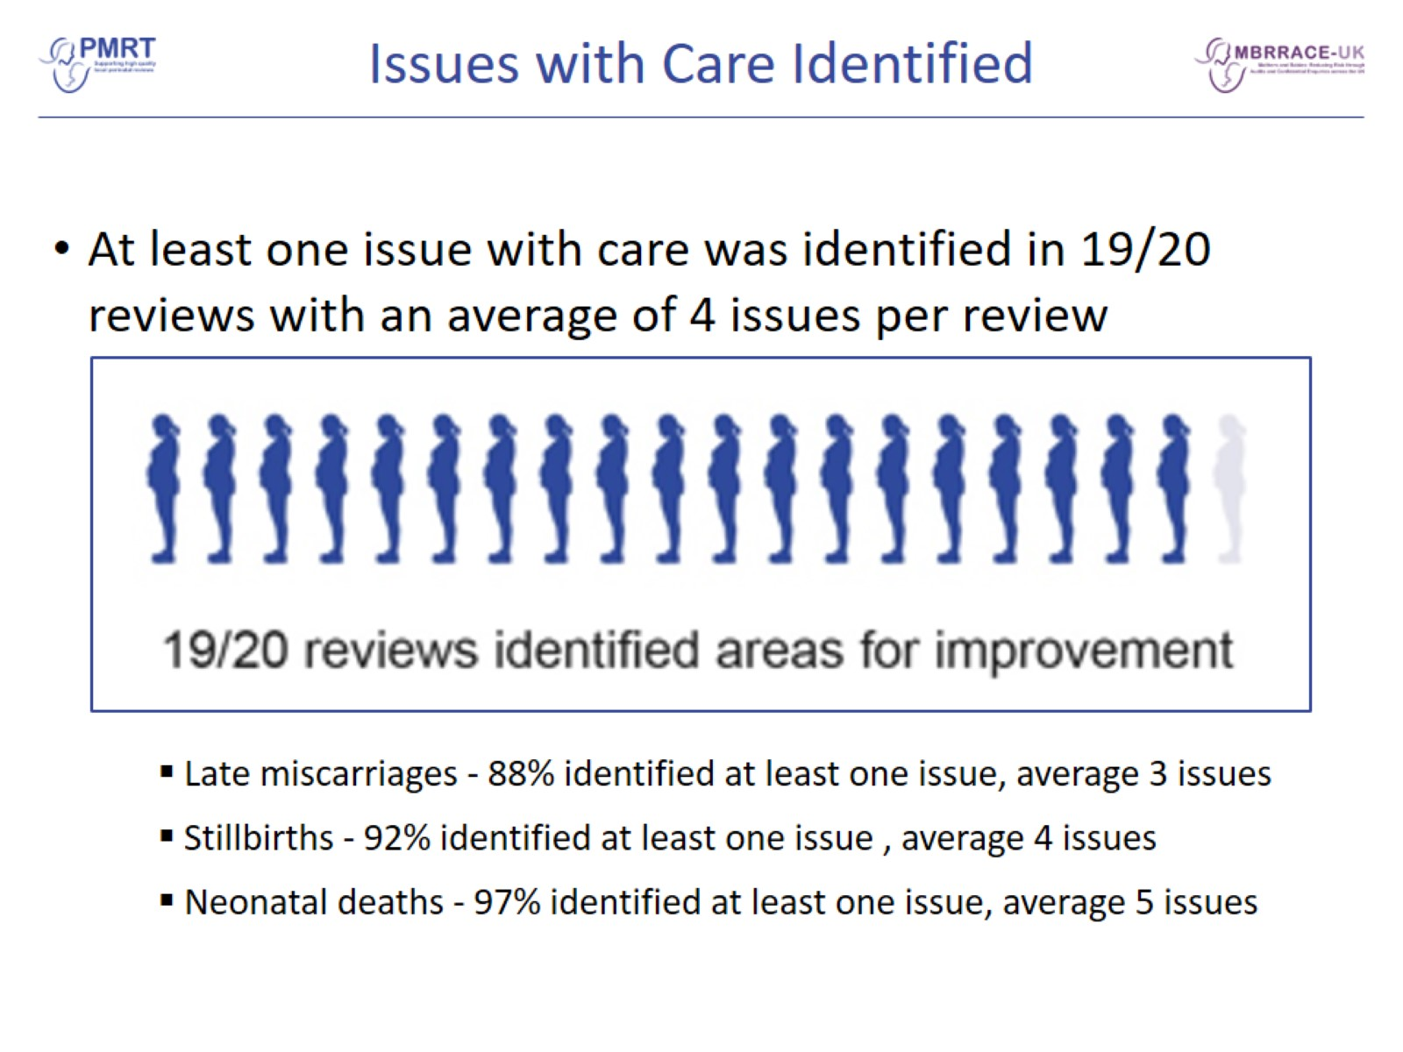
Issues with Care Identified

Slide 16
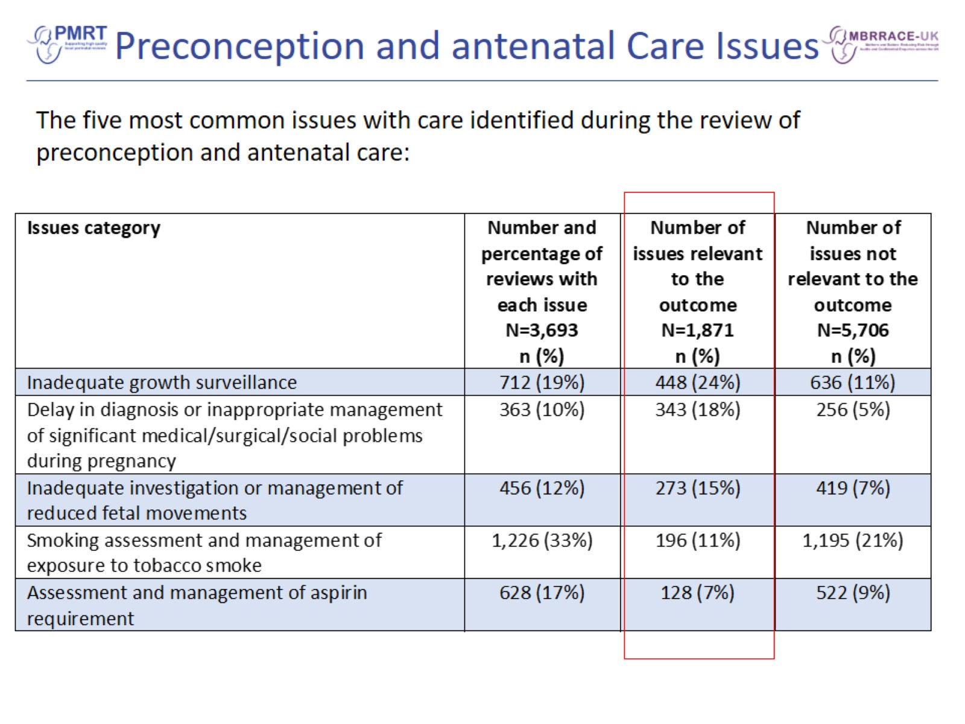
Preconception and antenatal Care Issues

Slide 17
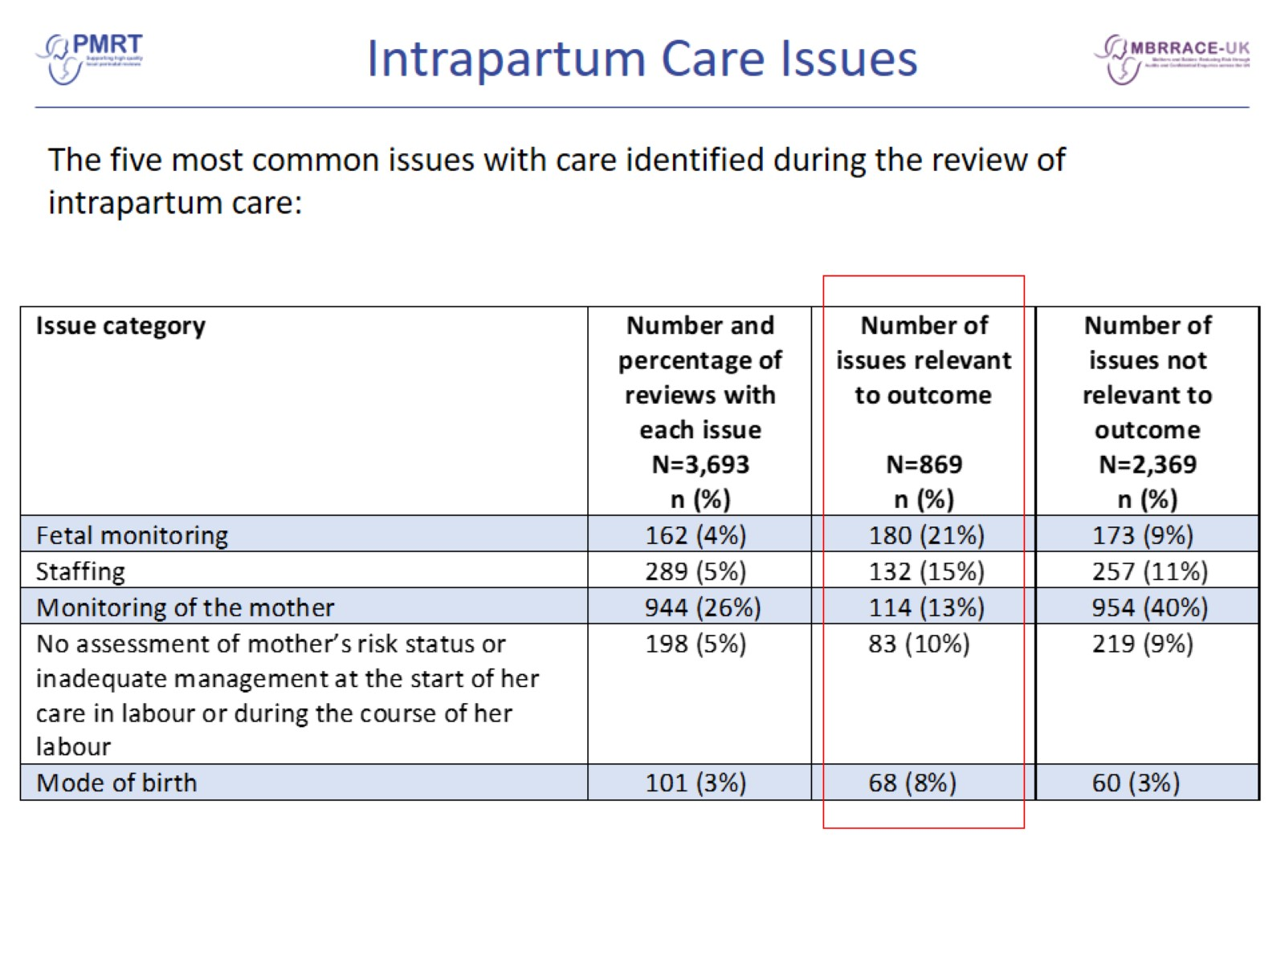
Intrapartum Care Issues

Slide 18
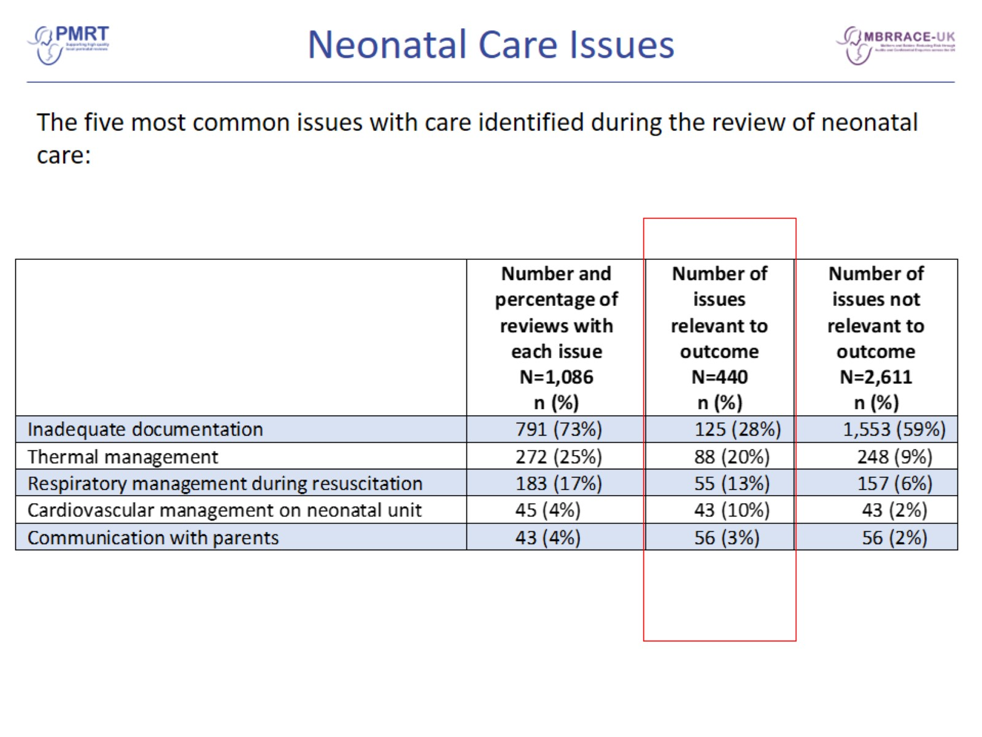
Neonatal Care Issues

Slide 19
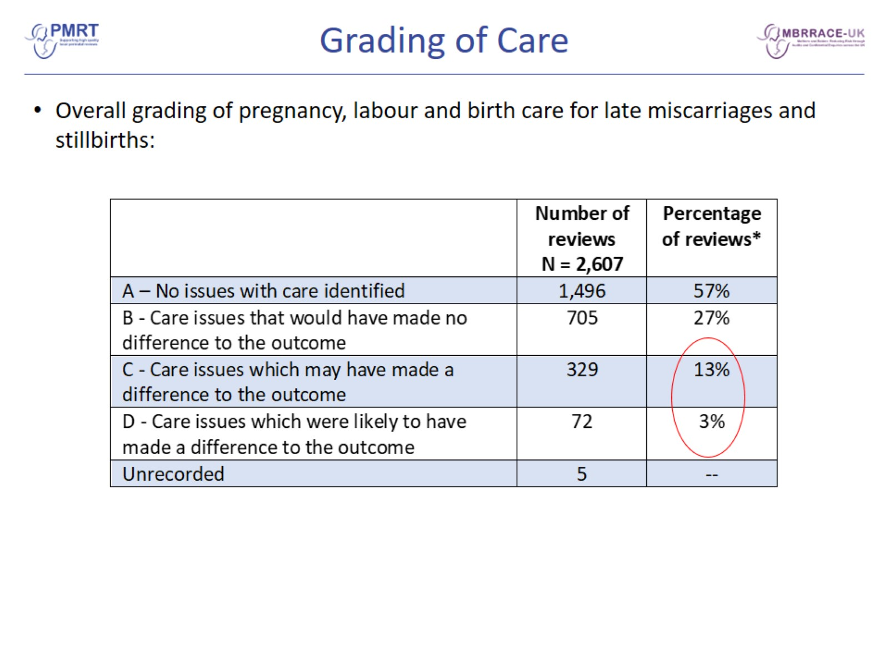
Grading of Care

Slide 20
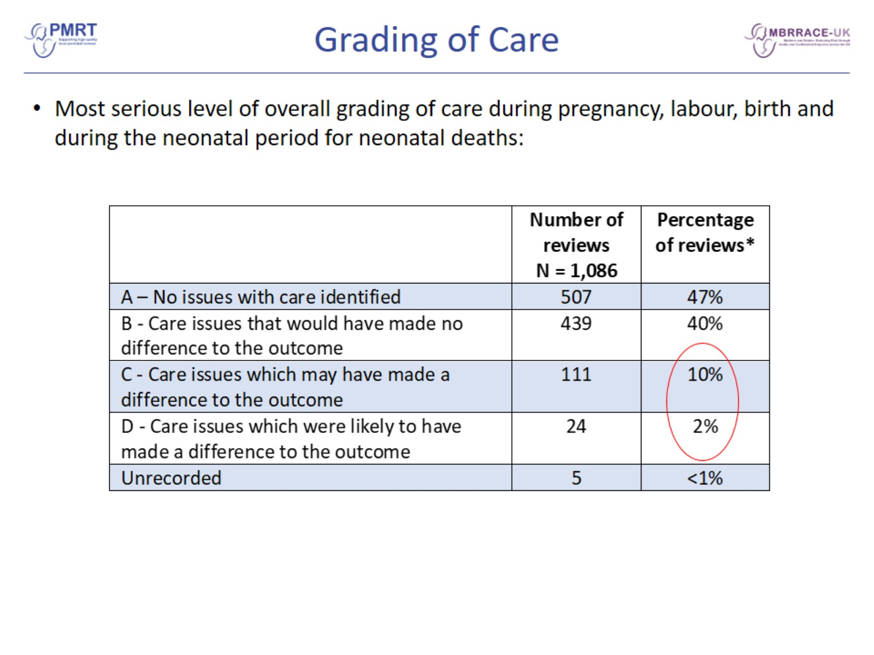
Grading of Care

Slide 21
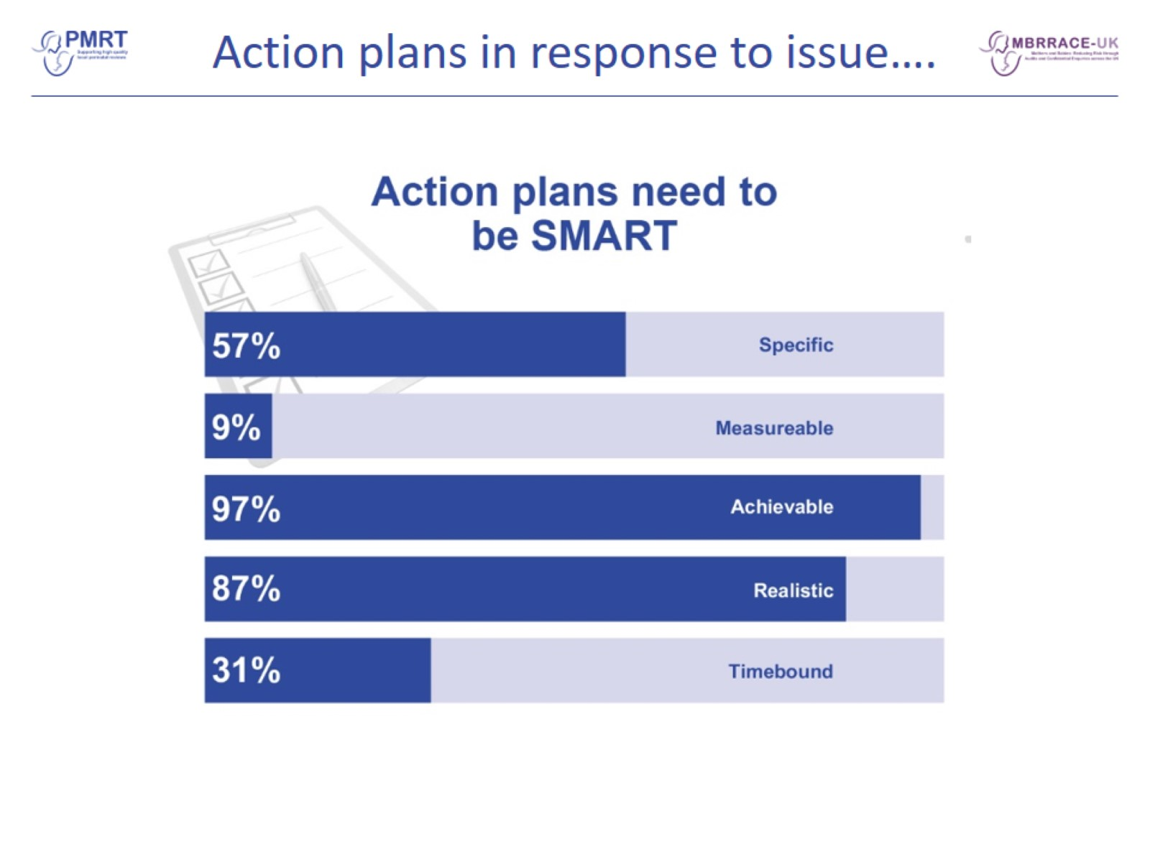
Action plans in response to issue….

Slide 22
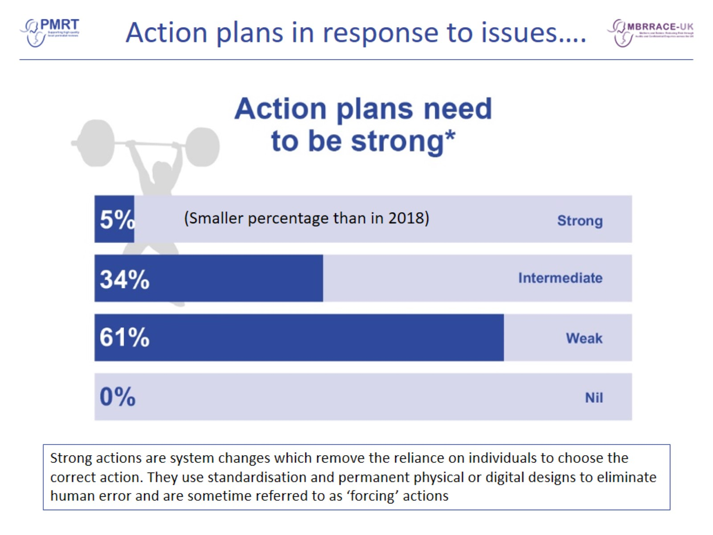
Action plans in response to issues….

Slide 23
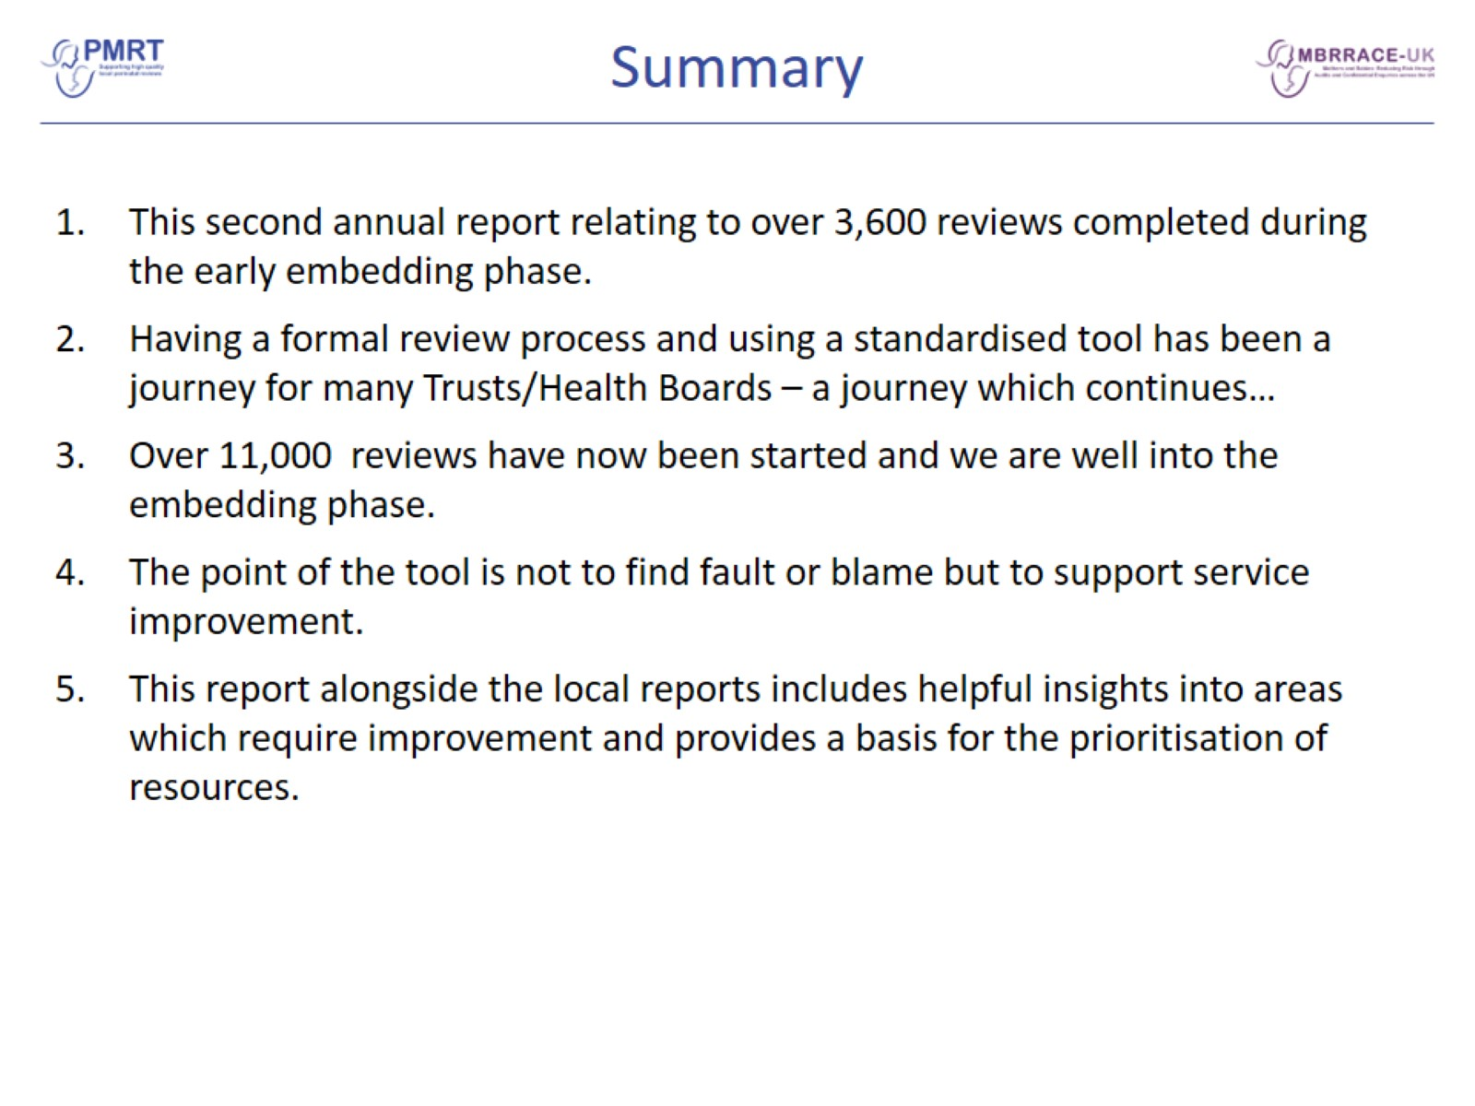
Summary

Slide 24
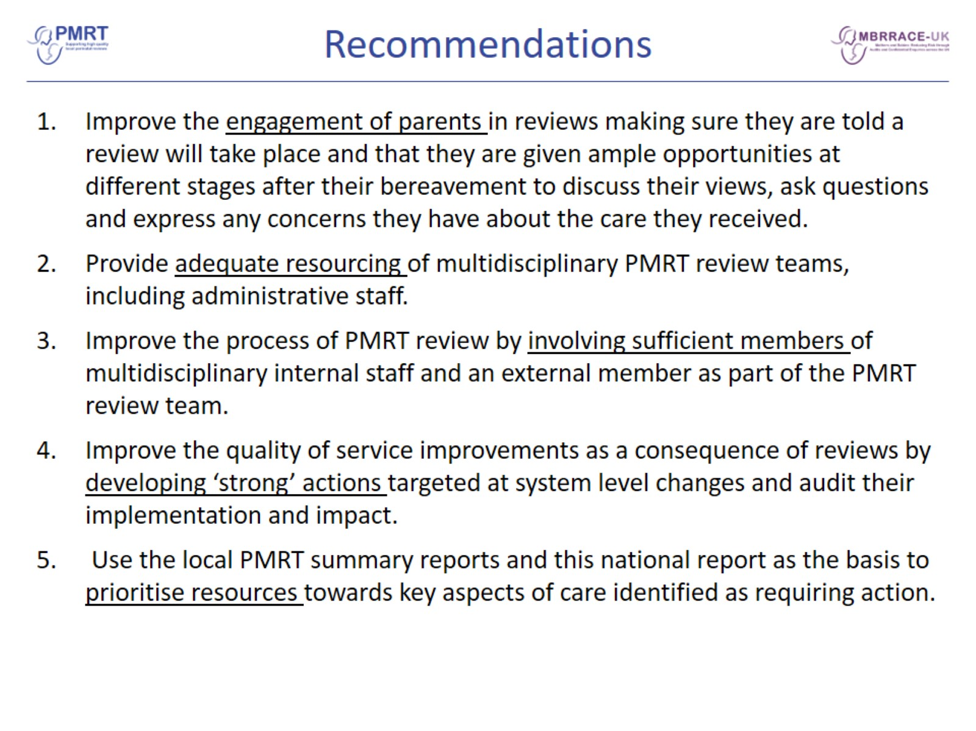
Recommendations

Slide 25
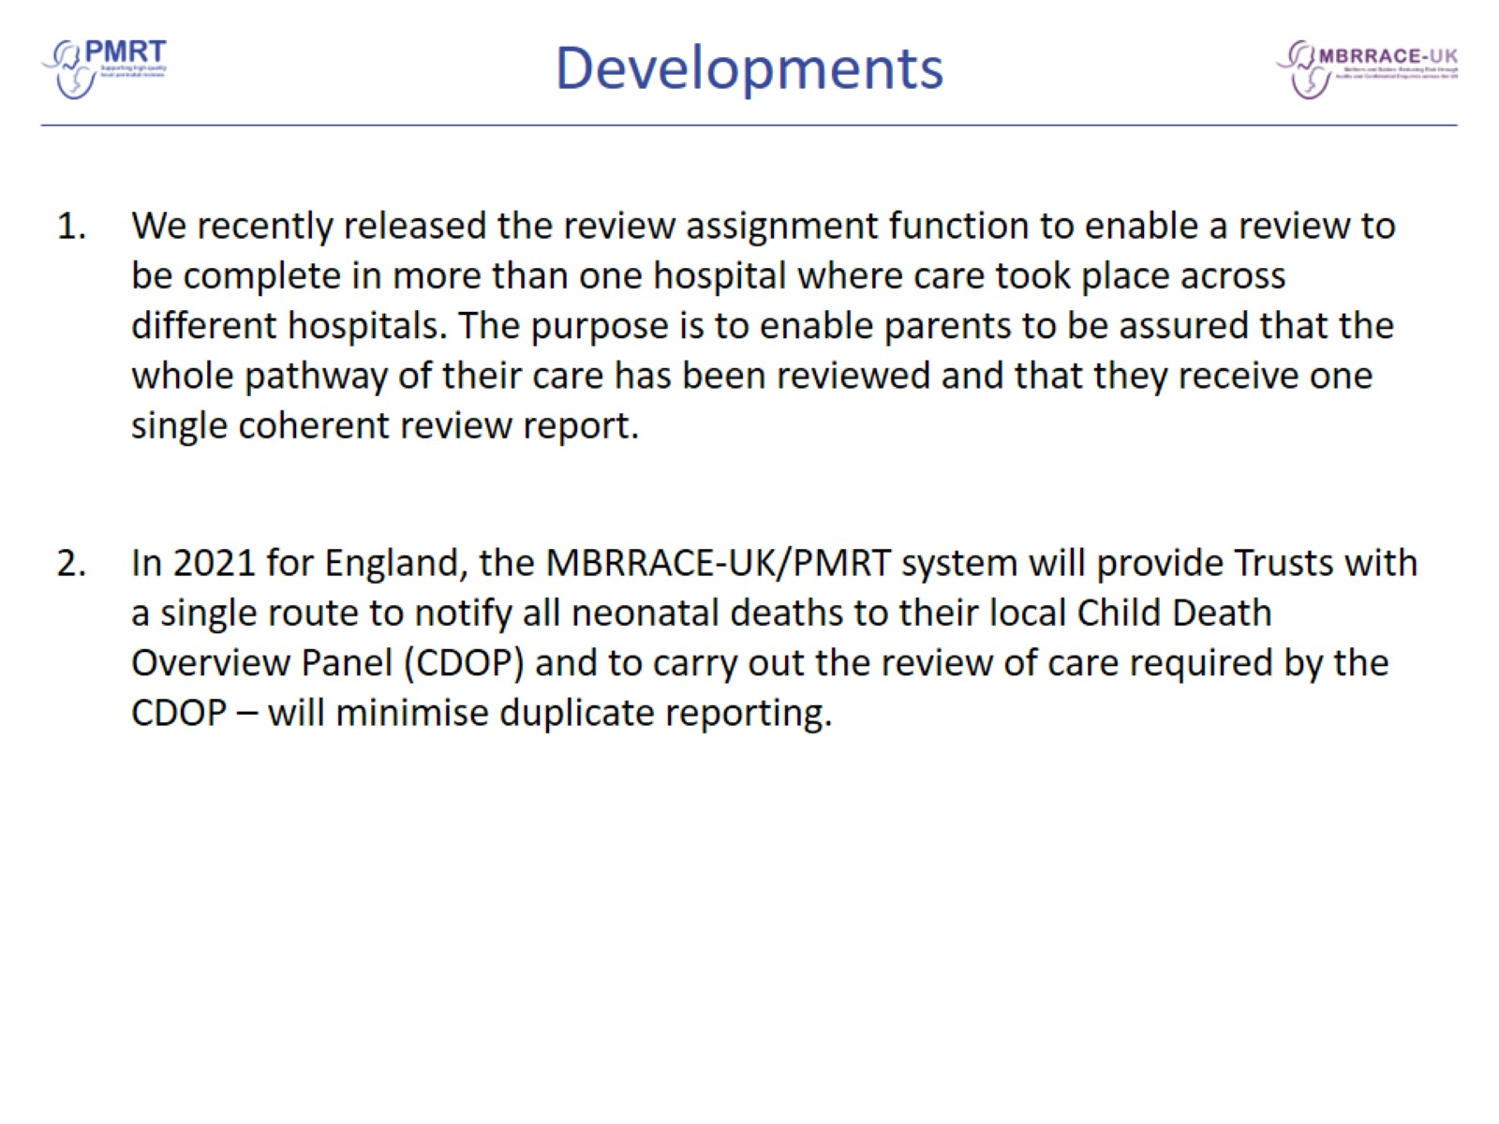
Developments

Slide 26

Acknowledgements

Slide 27
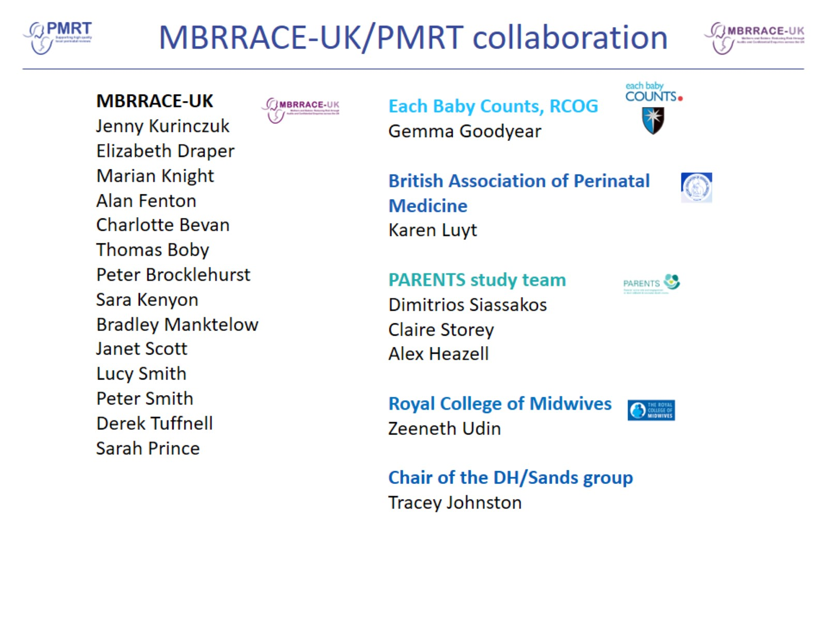
MBRRACE-UK/PMRT collaboration

Slide 28
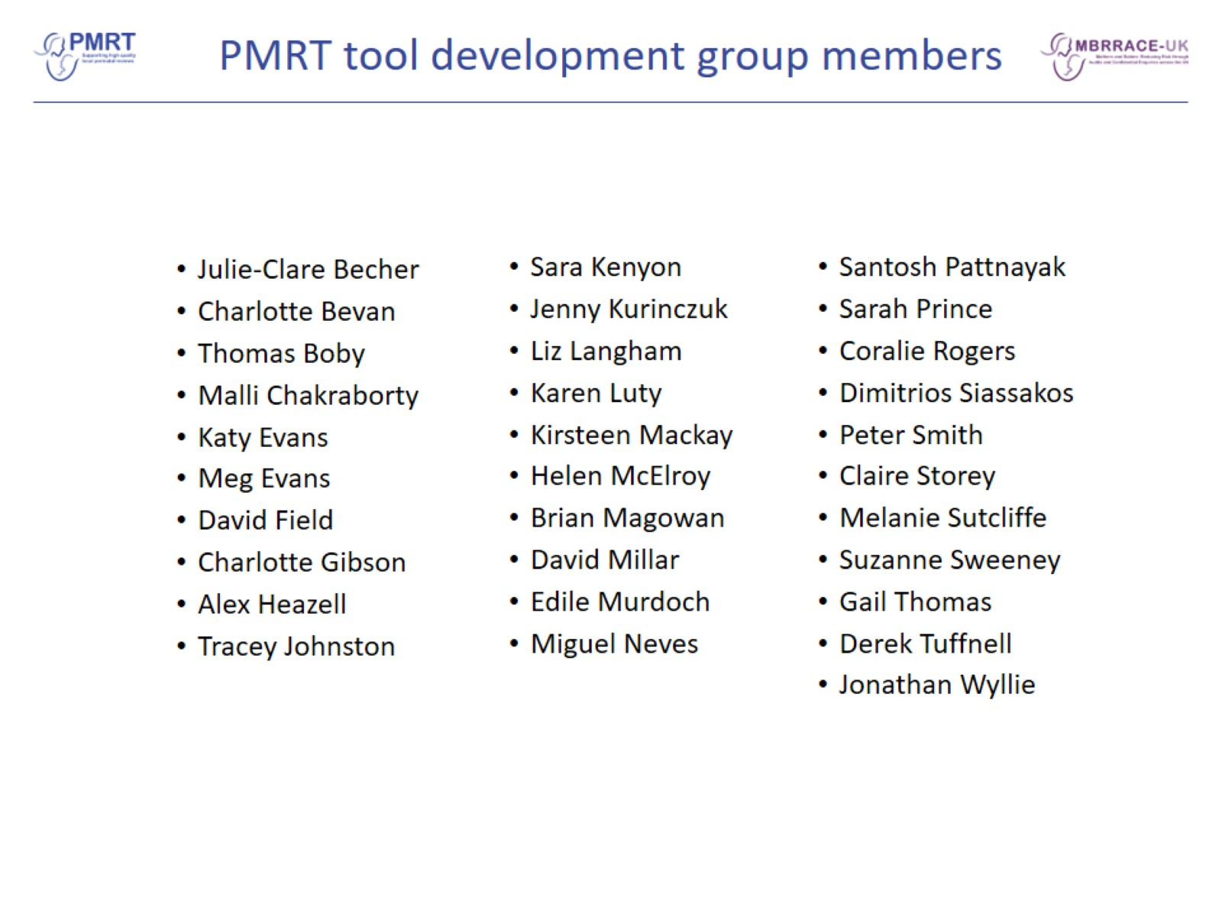
PMRT tool development group members

